Slide 1
Introduction to Node.JS & Express
Rami Sayar - @ramisayar
Technical Evangelist
Microsoft Canada

Slide 2
Agenda
Node.js Basics and Environment
Node Package Manager Overview
Web Framework Express Basics
Building a REST API with Node.js
Introduction to Yeoman

Slide 3
Why Should You Care?

Slide 4
1 – JavaScript
Notes:
JavaScript is an extremely popular language and is credited with being one of the driving forces that turned the web into the dynamic wonderland that it is today. What you can do in a browser nowadays, rivals all others.

Slide 5
2 – Unified Development Environment / Language
Notes:
Node.js lets you unify the programming language used by your app - no longer do you need a different language for your backend, you can use JavaScript throughout. If your background is in building and design websites and web app frontends in HTML, CSS and JavaScript, you don’t need to pick up another language to develop complex data-driven back-ends for your apps.

Slide 6
The Circumstances Resulting in Node.js

Slide 7
High-Performance JavaScript Engines - V8
Notes:
V8 is an open source JavaScript engine developed by Google.
V8 is written in C++ and is embedded in Google Chrome.
Node.js runs on V8.

Slide 8
Where is Node.js Now?
It was created by Ryan Dahl in 2009.
Still considered in beta phase.
Latest version is v0.10.31.
Open-source!
Supports Windows, Linux, Mac OSX

Slide 9
What is Node?
Node.js is a runtime environment and library for running JavaScript applications outside the browser.
Node.js is mostly used to run real-time server applications and shines through its performance using non-blocking I/O and asynchronous events.

Slide 10
When to use Node?
Node is great for streaming or event-based real-time applications like:
Chat Applications
Dashboards
Game Servers
Ad Servers
Streaming Servers
Online games, collaboration tools or anything meant to be real-time.
Node is great for when you need high levels of concurrency but little dedicated CPU time.
Great for writing JavaScript code everywhere!

Slide 11
Who uses Node?
Microsoft
Yahoo!
LinkedIn
eBay
Dow Jones
Cloud9
The New York Times, etc…

Slide 12
The Node Community
Five years after its debut, Node is the third most popular project on GitHub.
Over 2 million downloads per month.
Over 20 million downloads of v0.10x.
Over 81,000 modules on npm.
Over 475 meetups worldwide talking about Node.
Reference: http://strongloop.com/node-js/infographic/

Slide 13
Installing Node on Windows
aka.ms/node-101

Slide 14
Demo 1: Hello World

Slide 15
Demo 2: Hello World HTTP

Slide 16
Event-Driven Programming
“A programming paradigm in which the flow of the program is determined by events such as user actions (mouse clicks, key presses) or messages from other programs.” – Wikipedia

Slide 17
Node Event Loop
Node provides the event loop as part of the language.
With Node, there is no call to start the loop.
The loop starts and doesn’t end until the last callback is complete.
Event loop is run under a single thread therefore sleep() makes everything halt.
Notes:
http://strongloop.com/strongblog/node-js-event-loop/

Slide 18
Blocking I/O
var fs = require('fs');
var contents = fs.readFileSync('package.json').toString();
console.log(contents);

Slide 19
Non-Blocking IO
var fs = require('fs');
fs.readFile('package.json', function (err, buf) {
console.log(buf.toString());
});

Slide 20
Callback-Style Programming
Event loops result in callback-style programming where you break apart a program into its underlying data flow.
In other words, you end up splitting your program into smaller and smaller chunks until each chuck is mapped to operation with data.
Why? So that you don’t freeze the event loop on long-running operations (such as disk or network I/O).

Slide 21
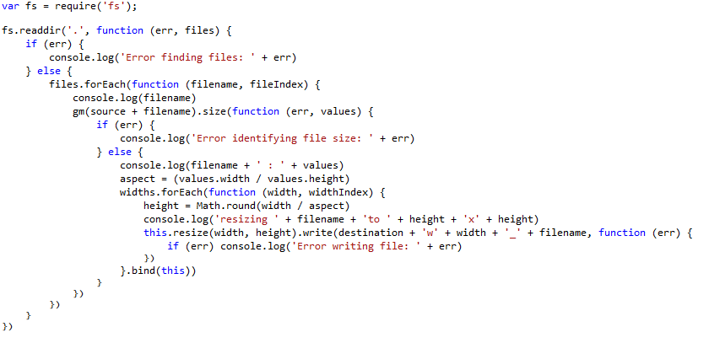
Callback Hell
http://callbackhell.com/

Slide 22
Promises-Style Programming
A function will return a promise for an object in the future.
Promises can be chained together.
Simplify programming of async systems.
Read More: http://spin.atomicobject.com/2012/03/14/nodejs-and-asynchronous-programming-with-promises/
Notes:
The idea behind Promise-based APIs is that a function will return a promise for an object in the future. Promises can be chained together and as each promise is fulfilled the next promise in line is executed. If a promise can’t be fulfilled it raises an error which can be handled, otherwise the chain of promises stops execution.

Slide 23
Q Library
step1(function (value1) {
step2(value1, function (value2) {
step3(value2, function (value3) {
step4(value3, function (value4) {
// Do something with value4
});
});
});
});
Q.fcall(promisedStep1)
.then(promisedStep2)
.then(promisedStep3)
.then(promisedStep4)
.then(function (value4) {
// Do something with value4
})
.catch(function (error) {
// Handle any error from all above steps
})
.done();

Slide 24
Follow Up Reading
James Coglan – “Callbacks are imperative, promises are functional: Node’s biggest missed opportunity”
https://blog.jcoglan.com/2013/03/30/callbacks-are-imperative-promises-are-functional-nodes-biggest-missed-opportunity/

Slide 25
Demo 3 - Basic TCP Server

Slide 26
Event Emitters
Allows you to listen for “events” and assign functions to run when events occur.
Each emitter can emit different types of events.
The “error” event is special.
Read More: http://code.tutsplus.com/tutorials/using-nodes-event-module--net-35941

Slide 27
Streams
Streams represent data streams such as I/O.
Streams can be piped together like in Unix.
var fs = require("fs");
// Read File
fs.createReadStream("package.json")
// Write File
.pipe(fs.createWriteStream("out.json"));

Slide 28
Modules and Export
Node.js has a simple module and dependencies loading system.
Unix philosophy -> Node philosophy
Write programs that do one thing and do it well -> Write modules that do one thing and do it well.

Slide 29
Require() Module Loading System
Call the function “require” with the path of the file or directory containing the module you would like to load.
Returns a variable containing all the exported functions.
var fs = require("fs");

Slide 30
What is NPM?
Official package manager for Node.
Bundled and installed automatically with the environment.
Frequent Usage:
npm install --save package_name
npm update

Slide 31
package.json
{
"name": "Node101",
"version": "0.1.0",
"description": "FITC Node101 Presentation Code",
"main": "1_hello_world.js",
"author": {
"name": "Rami Sayar",
"email": ""
}
}
http://browsenpm.org/package.json

Slide 32
Popular NPM Modules
Most Depended Upon
7053 underscore
6458 async
5591 request
4931 lodash
3630 commander
3543 express
2708 optimist
2634 coffee-script
https://www.npmjs.org/

Slide 33
How Does It Work?
Reads package.json
Installs the dependencies in the local node_modules folder
In global mode, it makes a node module accessible to all.
Can install from a folder, tarball, web, etc…
Can specify dev or optional dependencies.

Slide 34
Async Module
Async is a utility module which provides straight-forward, powerful functions for working with asynchronous JavaScript.
async.map(['file1','file2','file3'], fs.stat, function (err, results) {
// results is now an array of stats for each file
});
async.filter(['file1','file2','file3'], fs.exists, function (results) {
// results now equals an array of the existing files
});
async.parallel([
function () { },
function () { }
], callback);
async.series([
function () { },
function () { }
]);

Slide 35
Request Module
Request is designed to be the simplest way possible to make http calls. It supports HTTPS, streaming and follows redirects by default.
var request = require('request'); request('http://www.microsoft.com', function (error, response, body) {
if (!error && response.statusCode == 200) {
console.log(body);
}
});

Slide 36
What is Express?
Express is a minimal, open source and flexible node.js web app framework designed to make developing websites, web apps and APIs much easier.
Express helps you respond to requests with route support so that you may write responses to specific URLs. Express allows you to support multiple templating engines to simplify generating HTML.

Slide 37
Creating a Simple REST API
var express = require('express');
var app = express();
app.get('/', function (req, res) {
res.json({message:'hooray! welcome to our api!'});
});
app.listen(process.env.PORT || 8080);

Slide 38
Demo 4 – Sample Express App

Slide 39

What is Yeoman?

Slide 40
What is Yeoman?
Yeoman is a tool designed for front-end web developers.
Scaffolding tools similar to those in Rails.
Provides you a standardized starting project.
Helps you setup tasks with Grunt/Gulp and Package management with Bower/NPM.

Slide 41
Why Yeoman?
Notes:
Yeoman helps you standardize your projects alongside best practices and helps you get started with new projects much quicker. Often times, developers will refactor their naming conventions and file/folder patterns as their projects grow more complex. With a tool like Yeoman, you start off on the right track from the beginning and save valuable development time.

Slide 42

The Yeoman Workflow
Yeoman prescribes a workflow to improve your productivity and reduce your development time.
Notes:
Yeoman prescribes a workflow to improve your productivity and reduce your development time. The workflow is composed of three tools: yo (a scaffolding tool), Grunt (a build tool, alternatives are available) and a package manager (Bower, alternatives are available). Although all of the tools below are independent projects, they all work very well together to keep your project in good shape.
Yo is a tool written by the Yeomen team. It scaffolds out your new application, i.e. creates all the folders according to a best practice and sets up basic files like package.json or bower.json, etc.
Grunt is used to build, preview, serve and test your front-end app. You can also use Gulp.
Bower is used for dependency manager so that you don’t have to manually download and manage your scripts or just even manager the versions required. Bower will also take care keeping your scripts up to date with a simple command. You can also use npm.

Slide 43
Installing Yeoman
npm install -g yo
npm install -g bower (or nothing)
npm install -g grunt-cli (or gulp)
npm install -g yo bower grunt-cli

Slide 44
yo angular-fullstack [app-name]
Notes:
Yeoman helps you standardize your projects alongside best practices and helps you get started with new projects much quicker. Often times, developers will refactor their naming conventions and file/folder patterns as their projects grow more complex. With a tool like Yeoman, you start off on the right track from the beginning and save valuable development time.

Slide 45
What did we learn?
Node.js Basics and Environment
Node Package Manager Overview
Web Framework Express Basics
Introduction to Yeoman
Building REST APIs

